Slide 1



UNIT 8: Fit and healthy
Water’s the best

Slide 2
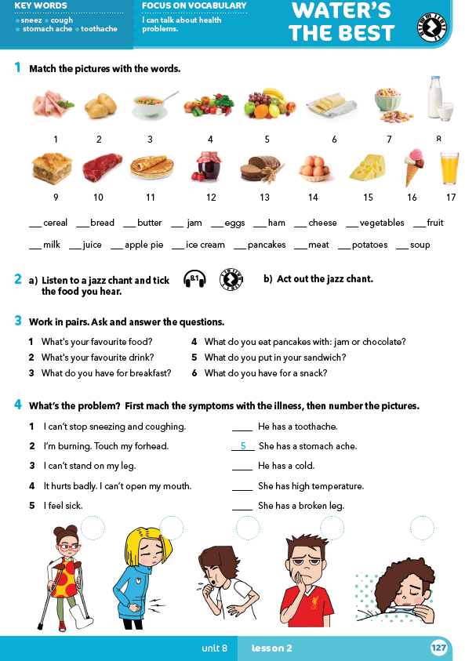
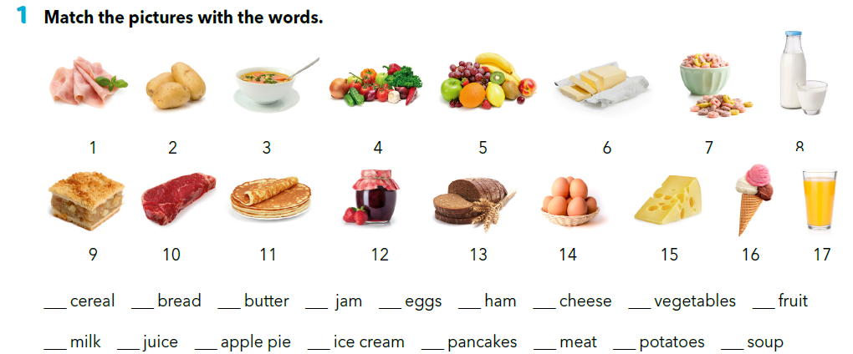
What do you like to eat on Sundays?
7
13
6
12
14
1
15
4
5
8
17
9
16
11
10
2
3
Do you know any other food that is not in the pictures?

Slide 3
7
13
6
12
14
1
15
4
5
8
17
9
16
11
10
2
3

Slide 4


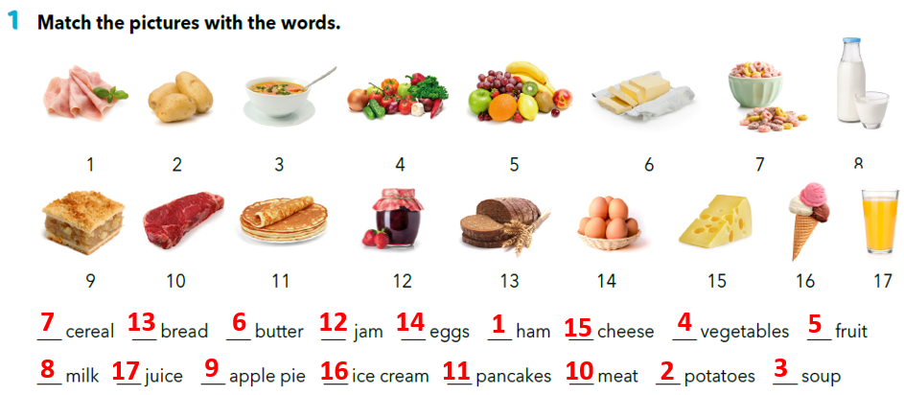
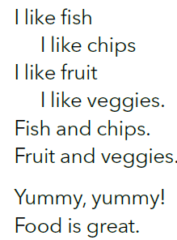
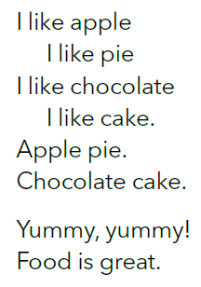
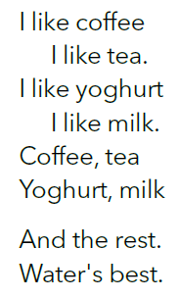

Practise.
https://quizlet.com/302509177/food-vocabulary-flash-cards/
https://www.e-sfera.hr/dodatni-digitalni-sadrzaji/128bc8e2-a872-43da-a8f4-d57973fc3010/assets/audio/59_jazz_chant.mp3
✓
✓
✓
✓

Slide 5
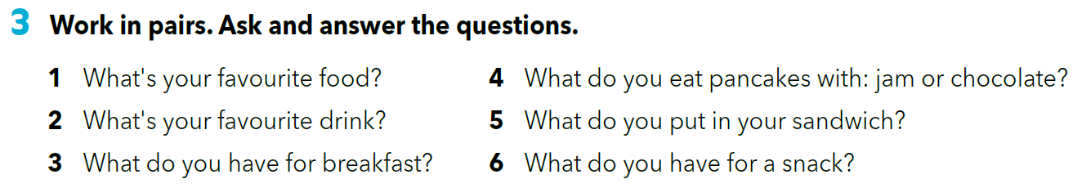

Slide 6
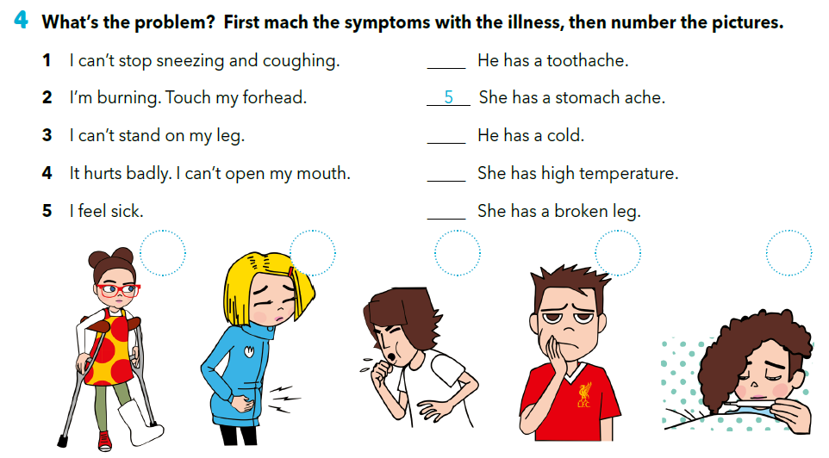
4
1
2
3
3
5
1
4
2

Slide 7
U parovima ili manjim grupama izradite stripove od 2 ili 3 sličice s naslovima:
„Unhealthy Molly” ili „Healthy Jim” ili „Happy Holly" ili „Sad Steve”
kojima prikazujete navike likova koji žive zdravo ili nezdravo, sretno ili tužno.
Stripovi mogu, ali ne moraju sadržavati tekst, no trebate osmisliti kratak govor kojim će objasniti zašto lik živi zdrav / nezdrav / sretan / tužan život.

Slide 8
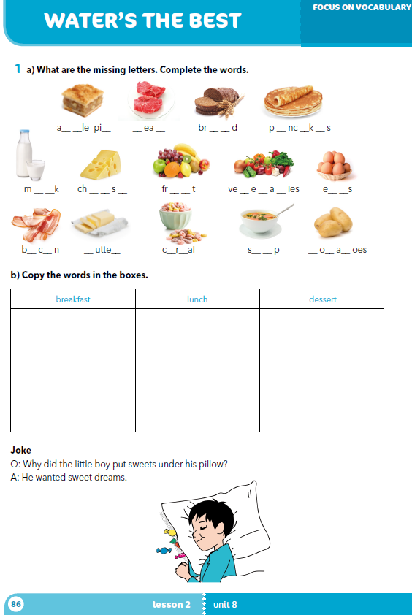
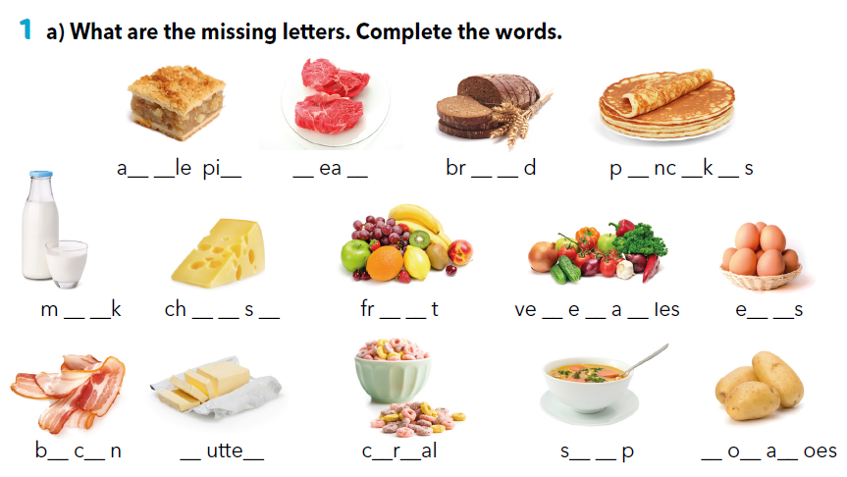
Workbook p 86.
p p
e
m
t
e a
a a
e
i l
e e e
u i
g t b
g g
a o
b r
e e
o u
p t t

Slide 9
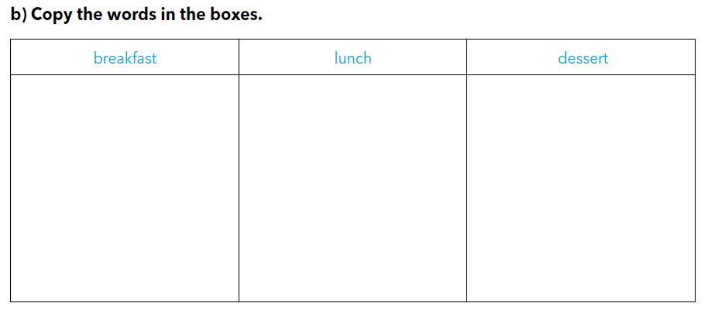
bread
milk
cheese
fruit
eggs
bacon
butter
cereal
meat
vegetables
soup
potatoes
apple pie
pancakes

Slide 10
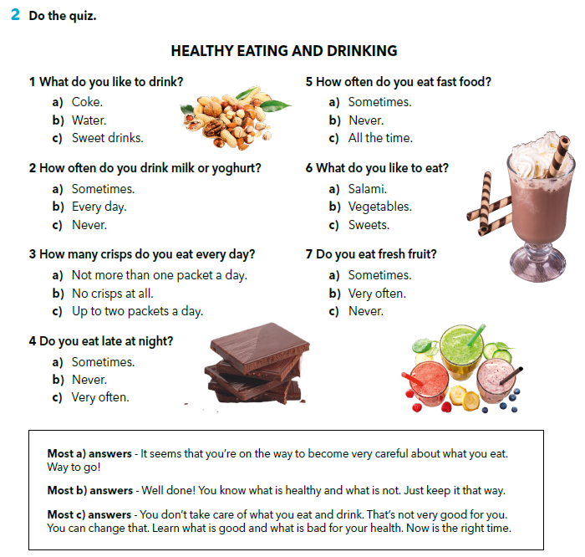

Slide 11

LET’S REVISE!
https://wordwall.net/play/261/694/830
SELF CHECK
https://www.e-sfera.hr/dodatni-digitalni-sadrzaji/128bc8e2-a872-43da-a8f4-d57973fc3010/

Slide 12
LEARN MORE
https://www.e-sfera.hr/dodatni-digitalni-sadrzaji/128bc8e2-a872-43da-a8f4-d57973fc3010/
Common health problems and what to do

